Slide 1
Fighting Climate Change in
Somalia’s Conflict Zones

Slide 2
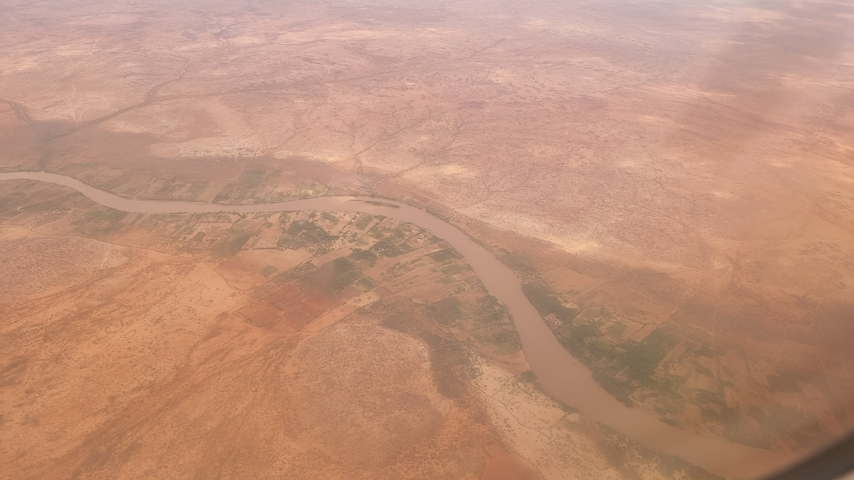
Somalia’s Climate Challenges

Slide 3
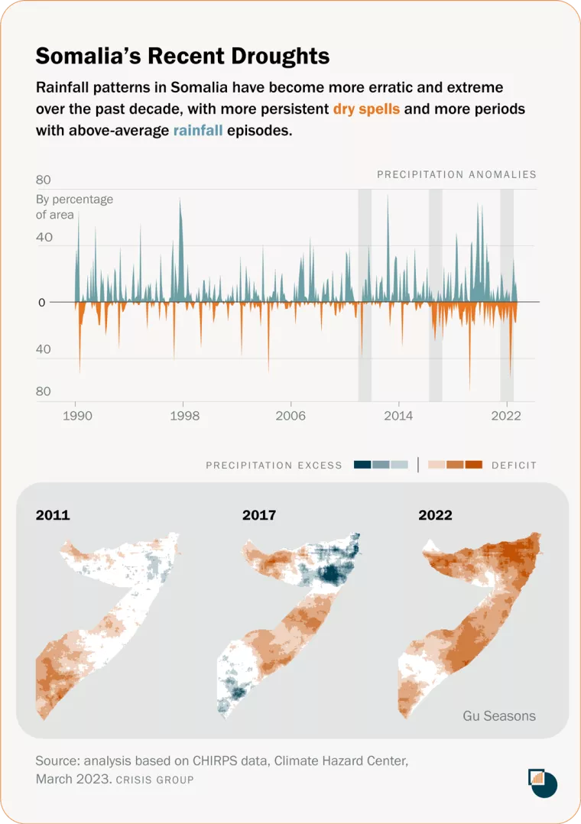

Slide 4
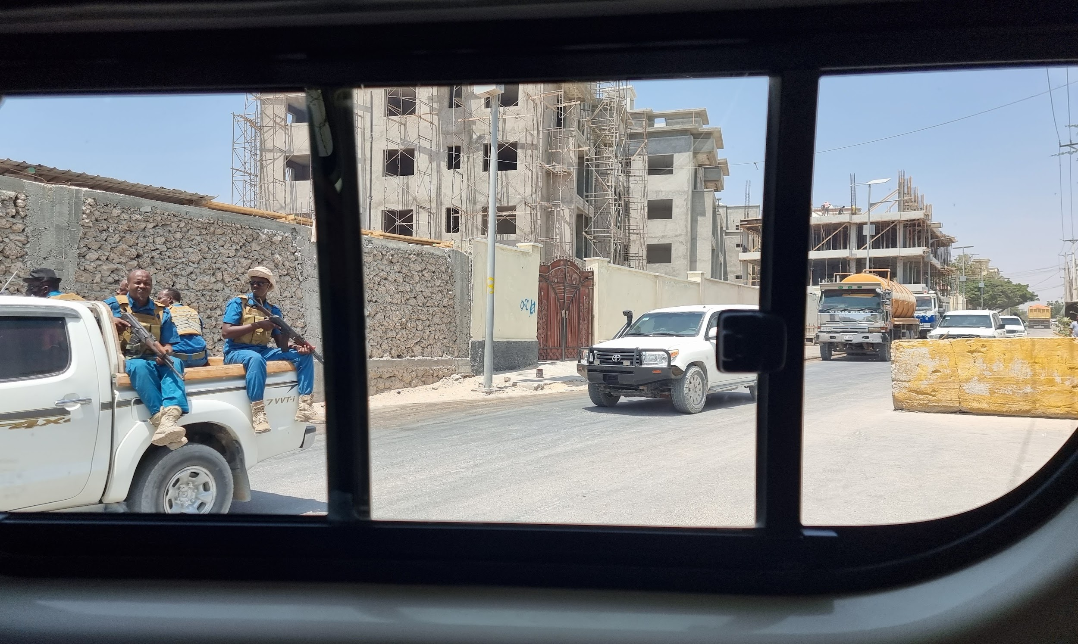
Security and Climate Change
The Environment
The Military Offensive and Beyond

Slide 5
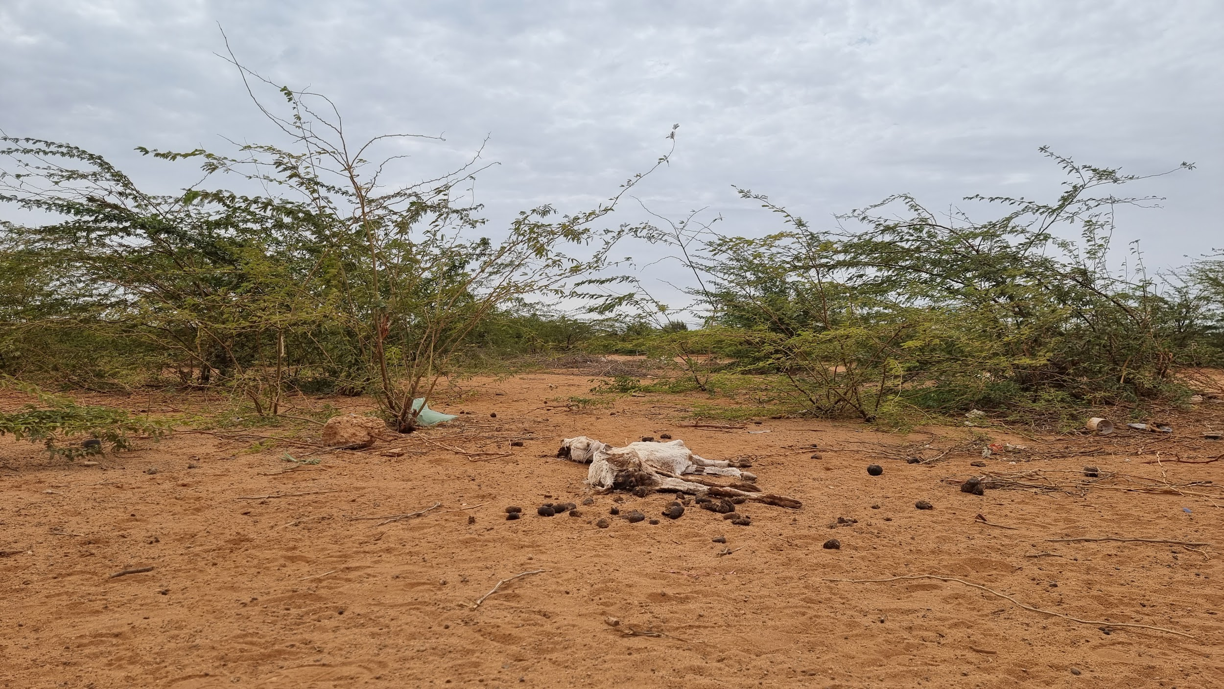
Al-shabaab and 2020-2023 Drought

Slide 6
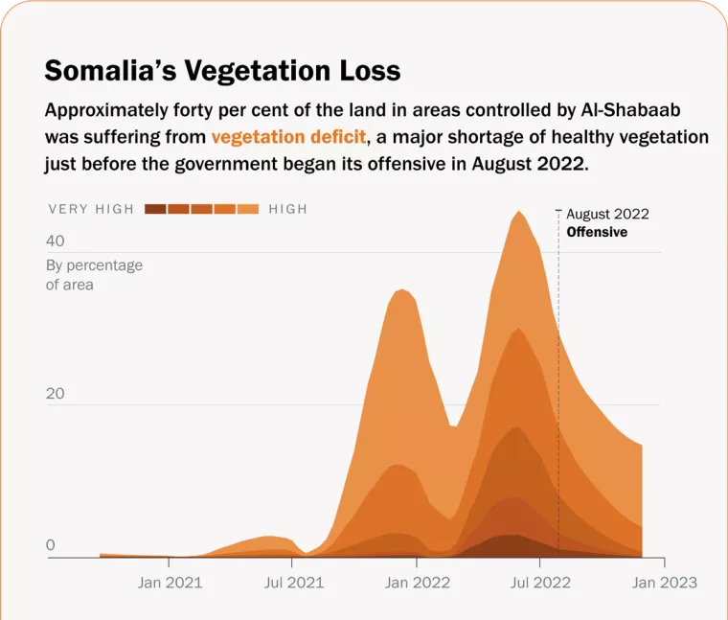

Slide 7
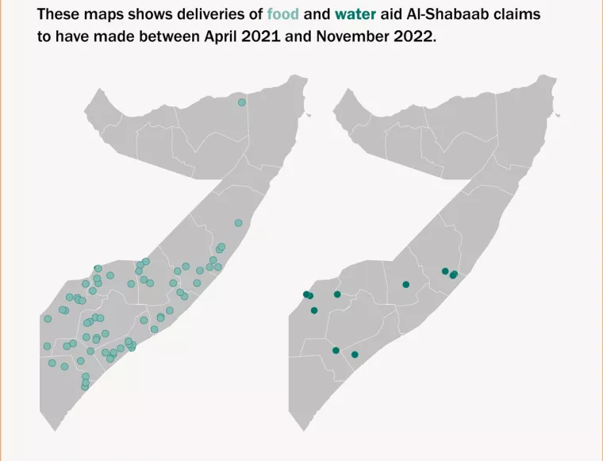

Slide 8
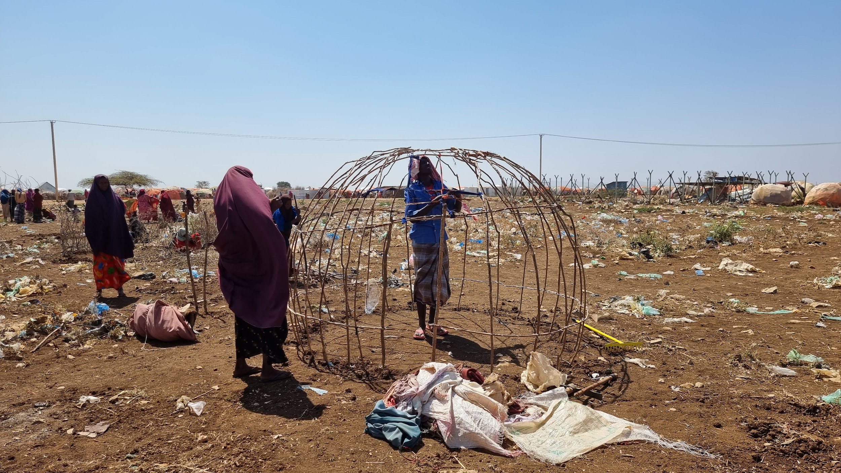
A Shift in Policy?

Slide 9
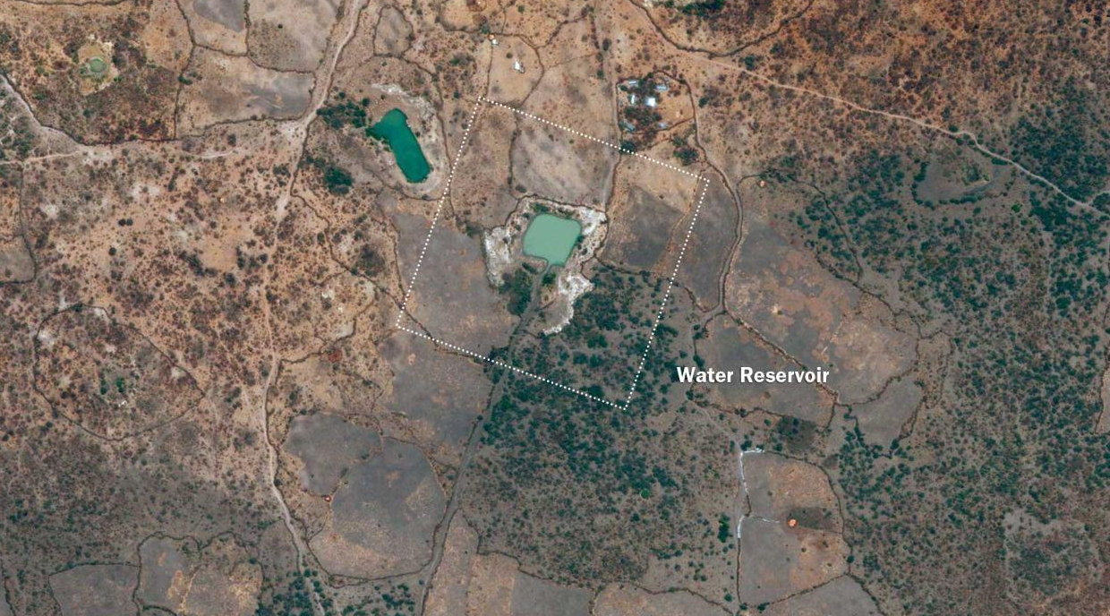
Satellite image of a water reservoir constructed in Buulo Fulaay, in Somalia's southern Bay region.
Before - March 2015

Slide 10
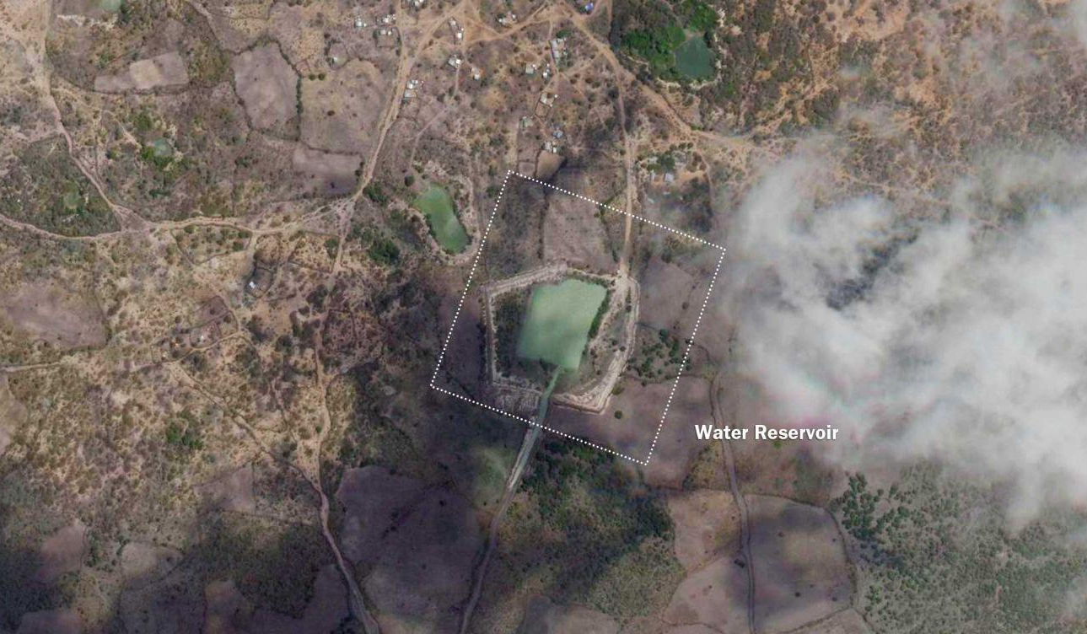
Widened the basin and more infrastructure around the canal between approximately 2021 and 2023, when the most recent drought began. (Maxar Technologies/Planet Labs)
After - July 2023

Slide 11
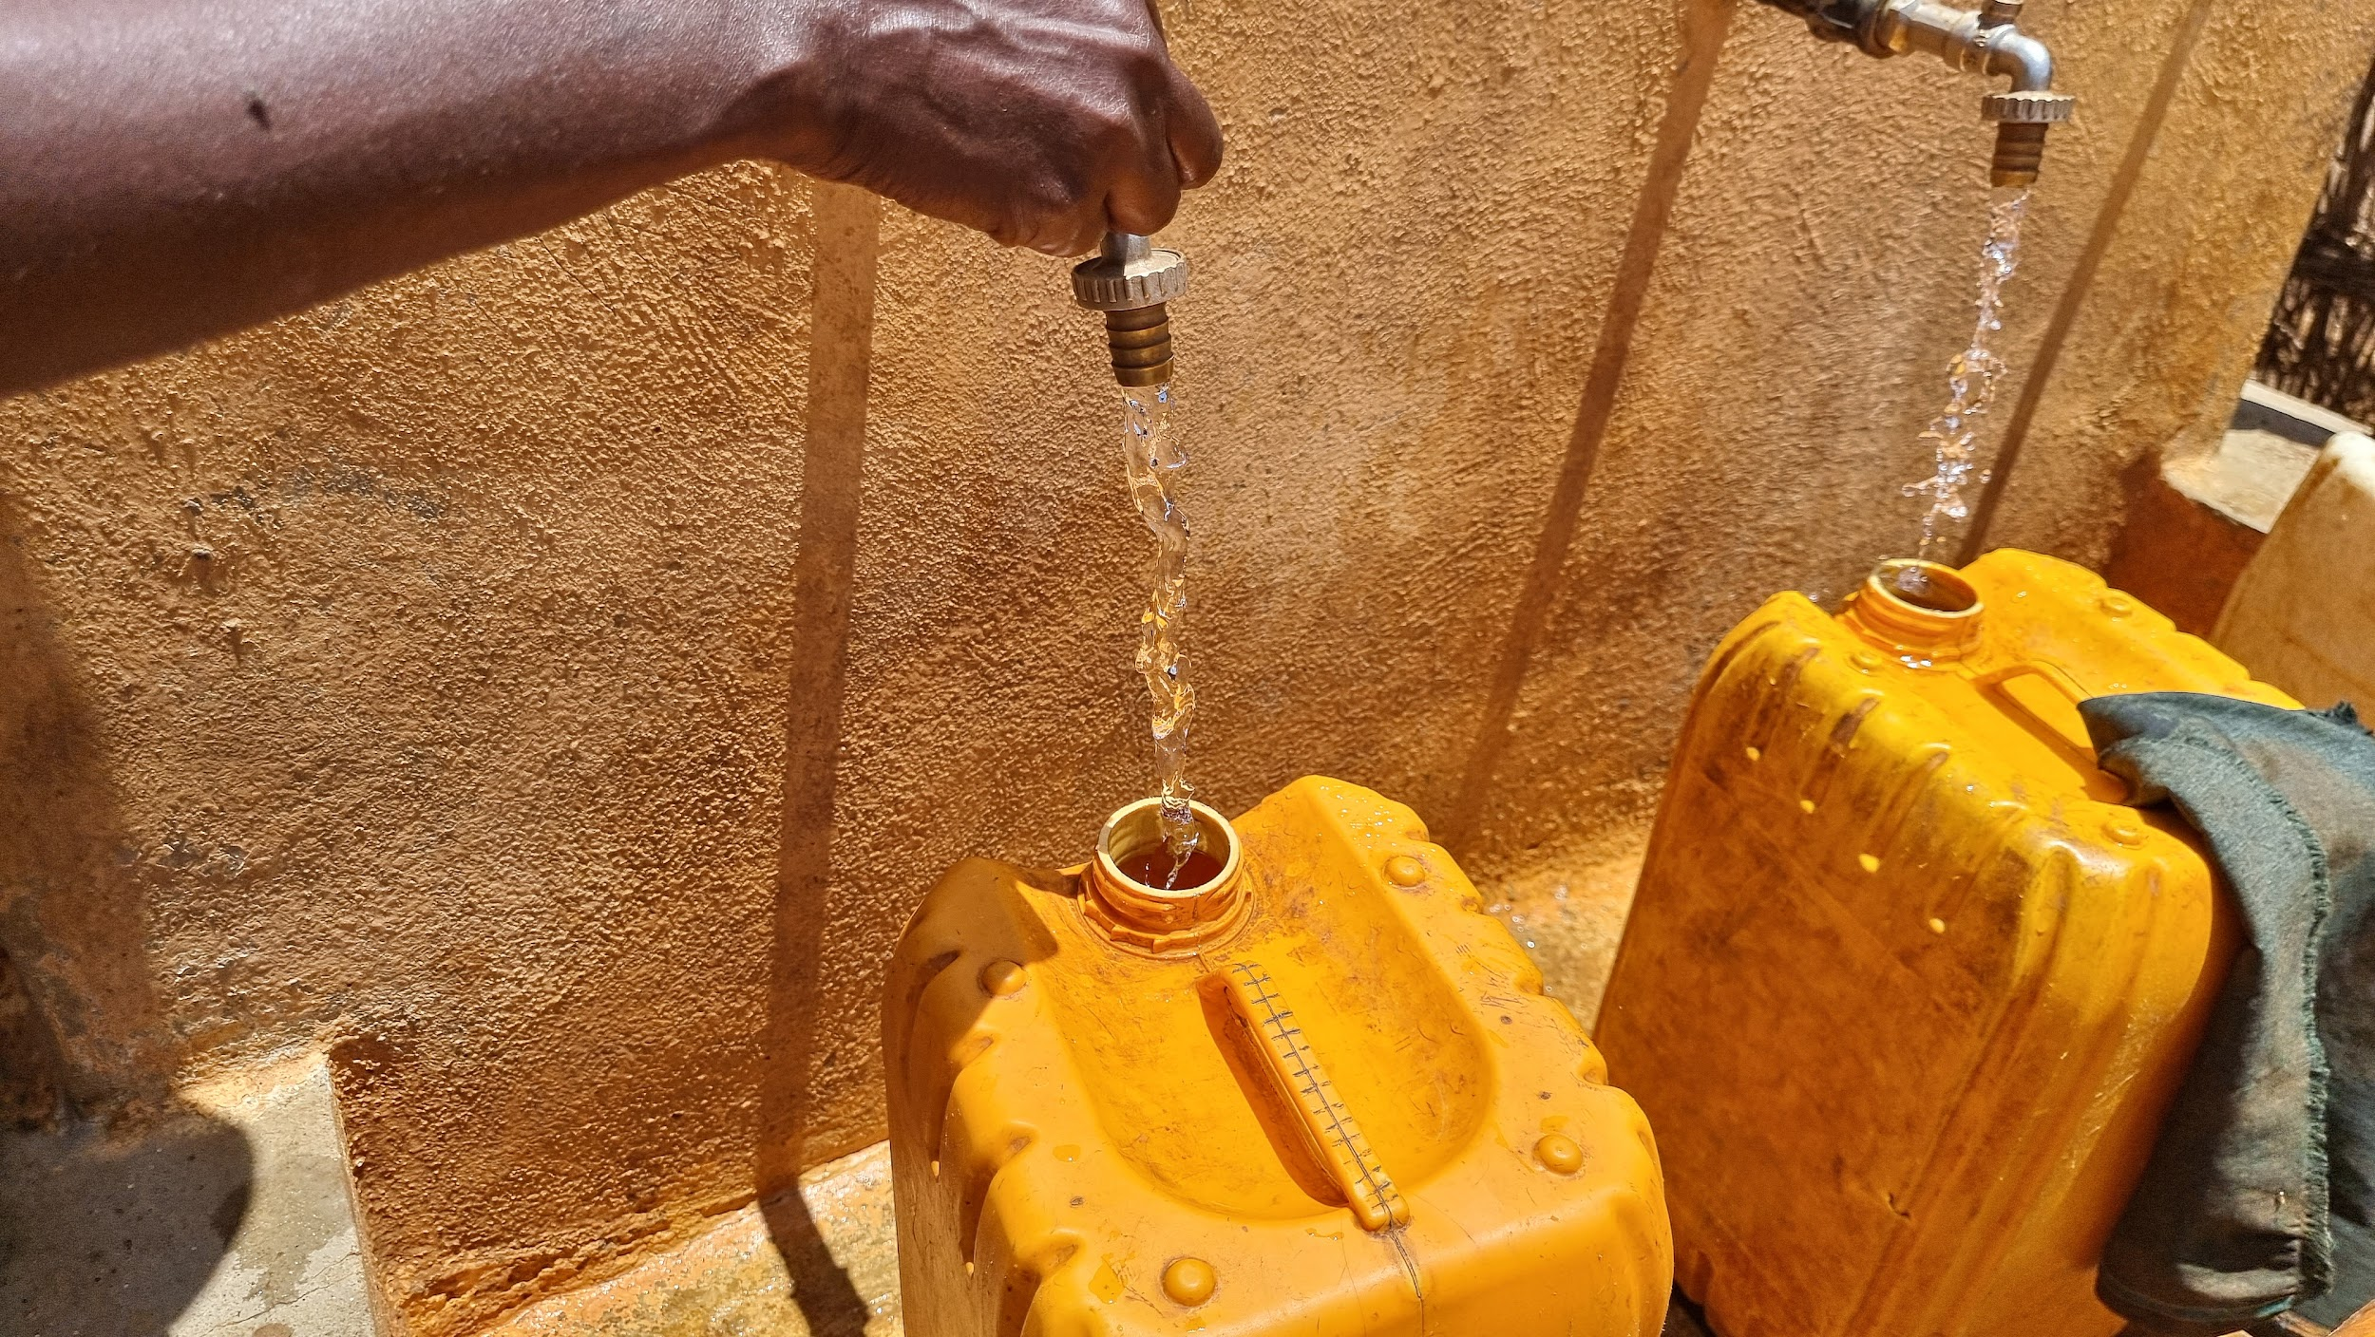
Tackling Climate Change’s Ill Effects
The Quest for Climate Funds
Managing Water, Fixing Infrastructure and Regenerating Land
.

Slide 12
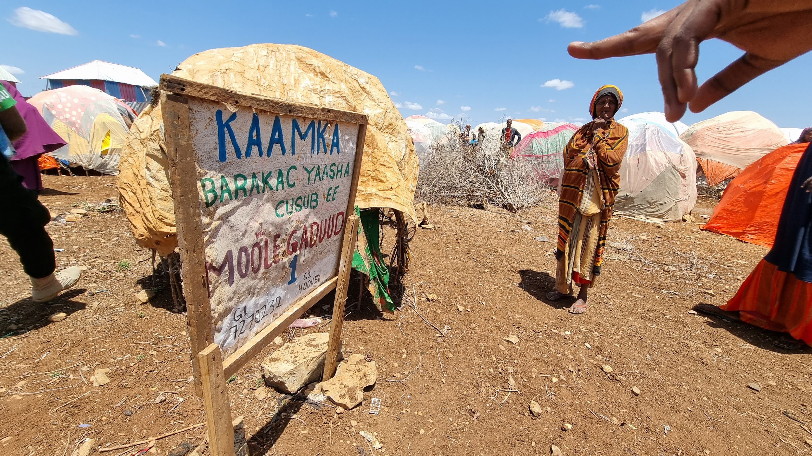
Handling Conflict Risks
Community Engagement and Conflict Mediation
Security Challenges
Lessons Learned and Resilience Building

Slide 13
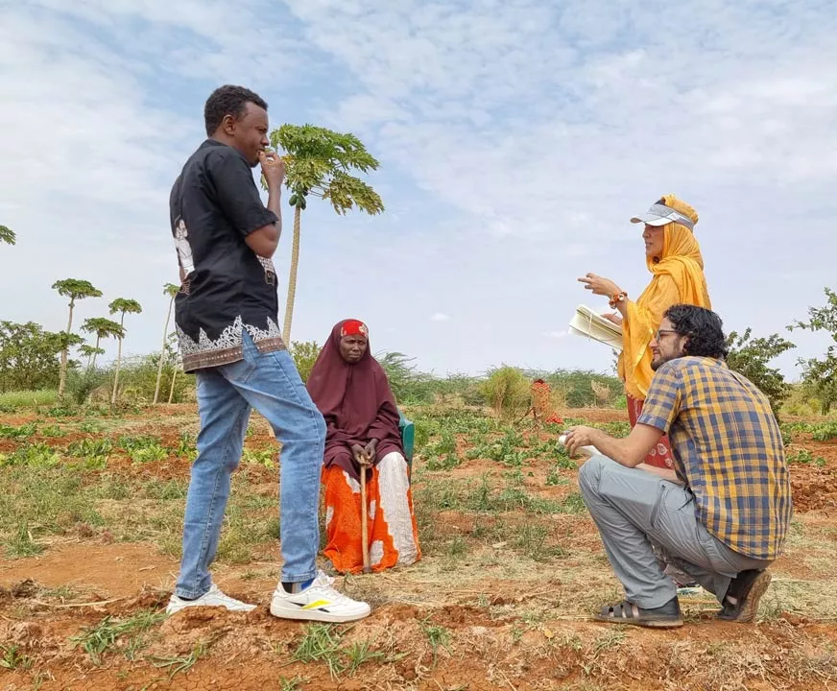
The Way Forward
Boosting Aid for Climate Resilience
Natural Resources in Liberated Territories
Climate Dialogues

Slide 14
Thank you
Nazanine Moshiri
Senior Analyst - Climate, Environment and Conflict
nmoshiri@crisisgroup.org

