Slide 1




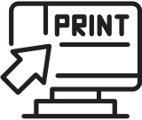

Mind your Printing
Green Printing Tips:
  Print only what you need to!
  B&W and double--sided
  Preview, then Print!
  If you print it, pick it up

