Slide 1
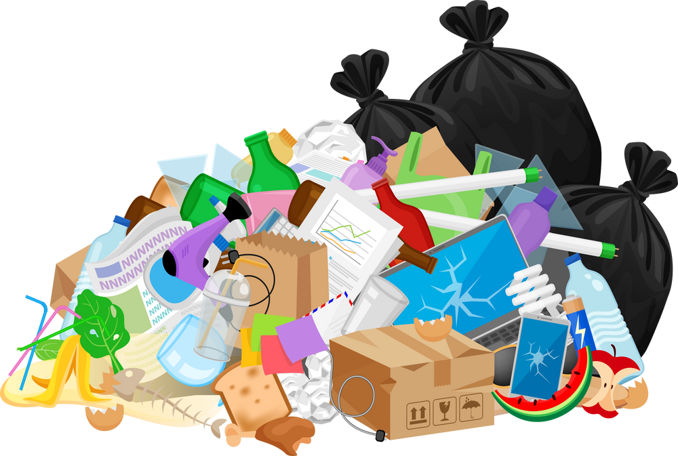



MSF - Decarbonization Solutions - FactSheets
Waste & Pollution
OUR COMMITMENT to 2030
50% Reduction of Waste (not set by all entities)
WHY it’s important
WHAT? MSF RoadMaps solutions
Humanitarian settings often lack alternatives, leading to uncontrolled final waste disposal.
Toxic waste substances can contaminate the air, water and soil, posing significant risks to human health and the environment. (Climate Action Accelerator)
  Avoid and reduce waste
    Reduce the use of single-use items
    Favor products donations through better anticipation of expiration dates and strict policy
  Increase local or regional recycling
  Repair of equipment over disposal
  Waste management plan and sorting specific to each context
  Limit soil, water and air pollution
The world generates 25 billion tons of solid waste every year, half of which is industrial waste. (World Bank, 2021)
Waste accounts for 5% of global GHG emissions (World Bank, 2021)
HOW? A Few recommendations
Refuse or avoid, then reduce, reuse or repurpose materials. Promote repair of electronic and electrical equipment
Composting organic waste reduces methane emissions from landfills by 78%.
Recycle and dispose of remaining waste responsibly and explore existing infrastructure.
(Global Alliance for Incineration Alternative, 2022)

