Slide 1
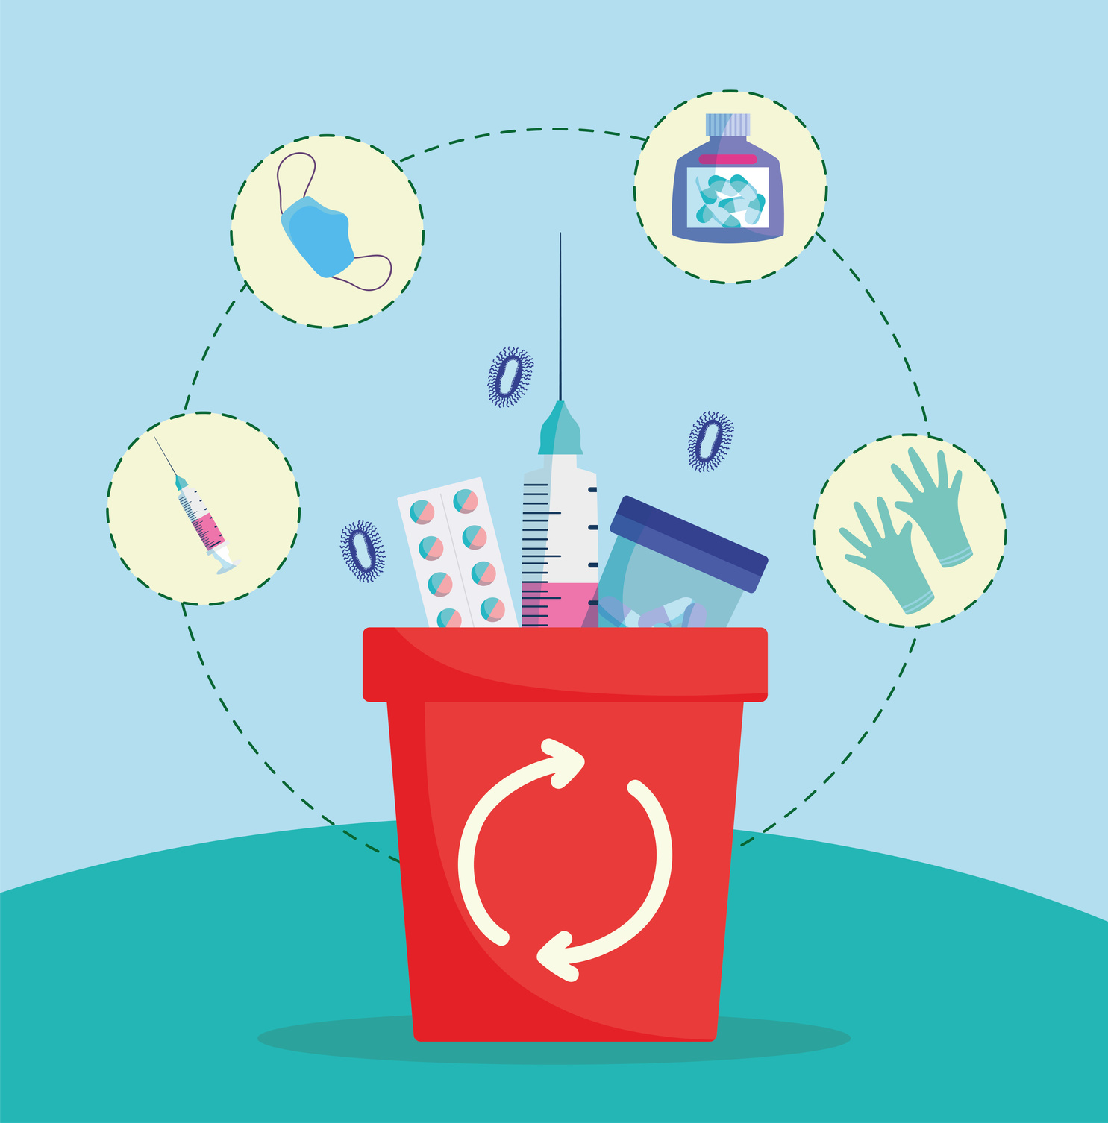



MSF - Decarbonization Solutions - FactSheets
Medical Practices
OUR COMMITMENT to 2030
Reduce overuse of medical items & reduce amount of medical waste (including proper waste segregation)
WHY it’s important
WHAT? MSF RoadMaps solutions
Medical practices are central to MSF’s medico-humanitarian operations.
Train medical staff on updated protocols (those that are already recommended)
Rationalize selection, ordering and dispensing of drugs
Optimize the ordering, use and maintenance of medical equipment
Alternative medical materials/products with lower environmental impact
Switch to longer lasting medical and alternative medical products
Rationalization of use to single use items
60% of Medical Items ordered are Single-use items.
Single-use items are the main contributors to medical waste.
Gloves are by far the most used single-use medical item
PPE and IV drug delivery items are the two top contributors of single-use categories.
HOW? A Few recommendations
Efficient forecasting and stock management ensure that we minimize quantity of expired items
Lead by Example: Follow best practices with proper implementation of medical protocols
Behavior change is the most effective way to reduce single-use item impact on the environment.
https://apps.epicentre-msf.org/public/app/carbon-travel-app

