Slide 1
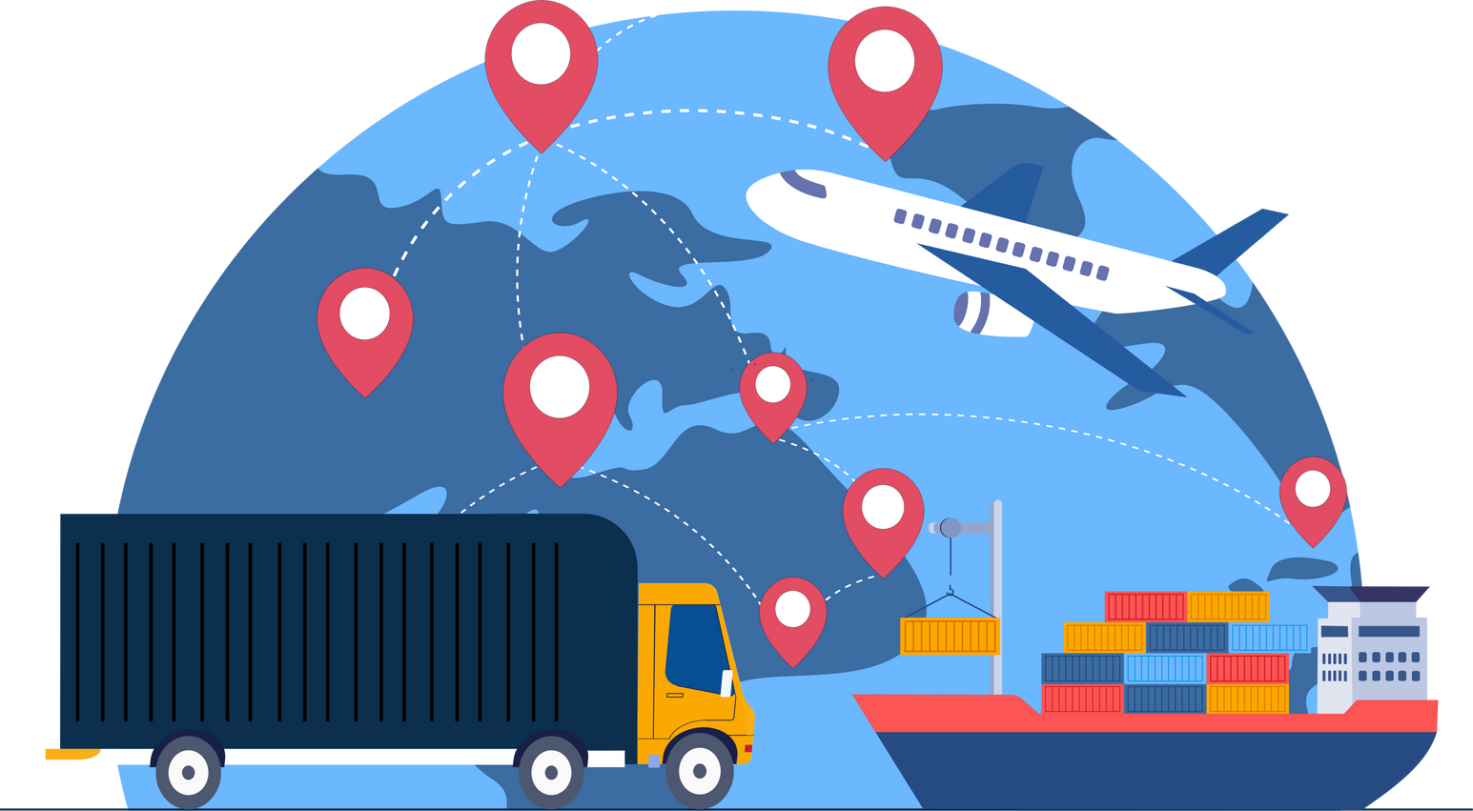



MSF - Decarbonization Solutions - Fact-sheets
Sustainable Supply Chain
Good & Services
We will focus on reducing the need for goods and services. For necessary purchases, we’ll choose low-carbon, eco-friendly options that meet quality standards, prioritizing suppliers with strong sustainability practices and goods produced near end-users.
OUR COMMITMENT to 2030
  Reduce 25-30% CO₂e linked to Goods & Services purchased.
  Assess 100% of suppliers who spend > 100k€ against sustainability and sign Code of Conduct
WHY it’s important
WHAT? MSF RoadMaps solutions
Half of our carbon footprint comes from purchase of goods and services!
  Reduce unnecessary material purchases
  Improve forecasting to avoid overstock
  Choose items, services and suppliers with a lower environmental footprint
    Request visibility on product components and life cycle of items/products
    Identify lower carbon/waste generating alternatives for most important/relevant items
    Include environmental criteria for services and products in the sustainable procurement guidelines and/or procedures
  Choose suppliers engaged in their environmental impact by assessing those who spend >100k against sustainability performance
  Work with suppliers to reduce volume and weight as well as harmful substances in items/packaging
  Local/regional purchasing
Sustainable procurement is not the sole responsibility of people in charge of procurement. Requesters and budget holders play a critical role in setting criteria and validating purchase of goods that are more sustainable.
Procurement accounts for 40-60% of a product’s carbon footprint (Climate Action Accelerator)
HOW? A Few recommendations
Include sustainability in the comparative bid analysis by assigning 10-20% weight when selecting a product or supplier
Use EcoVadis or the Sustainability Questionnaire to support and guide suppliers towards sustainability.
Include product/service specific criteria. Contact
sustainable.procurement@msf.org
Sustainable Procurement Video

